Slide 1

Convenience At Your Fingertips
Applications Security Project| SF-1802

Slide 2
Introduction
E-commerce app that allows users to
Buy
Sell
Loan
Pre-order food

Slide 3




Create a session for user
Auto-login user to Home Page
Registration Process
Save User Record
‘Register’
Validation
Hash and Salt Password
Validation Failed
User/Email Exists

Slide 4
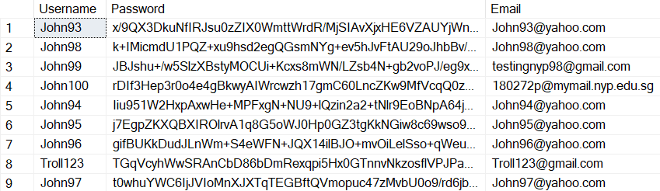
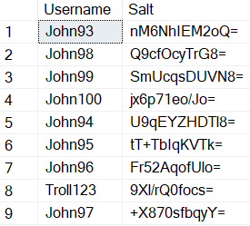
‘Users’ Table
‘Salt’ Table

Slide 5
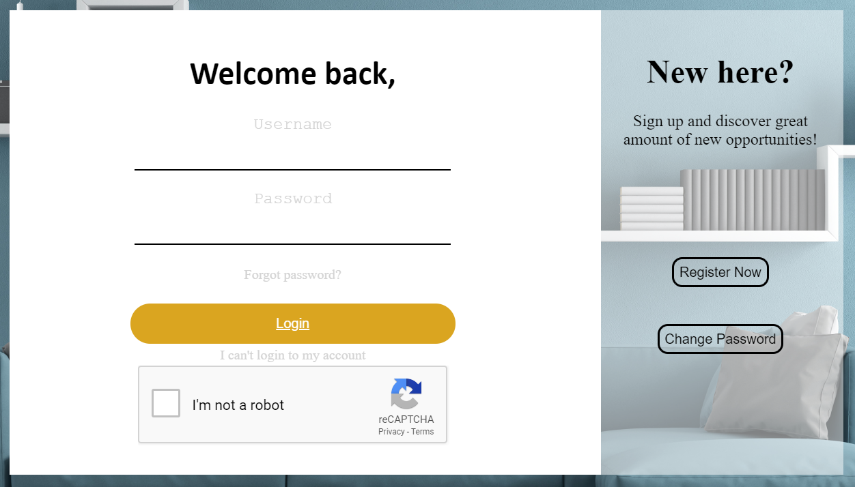

Slide 6
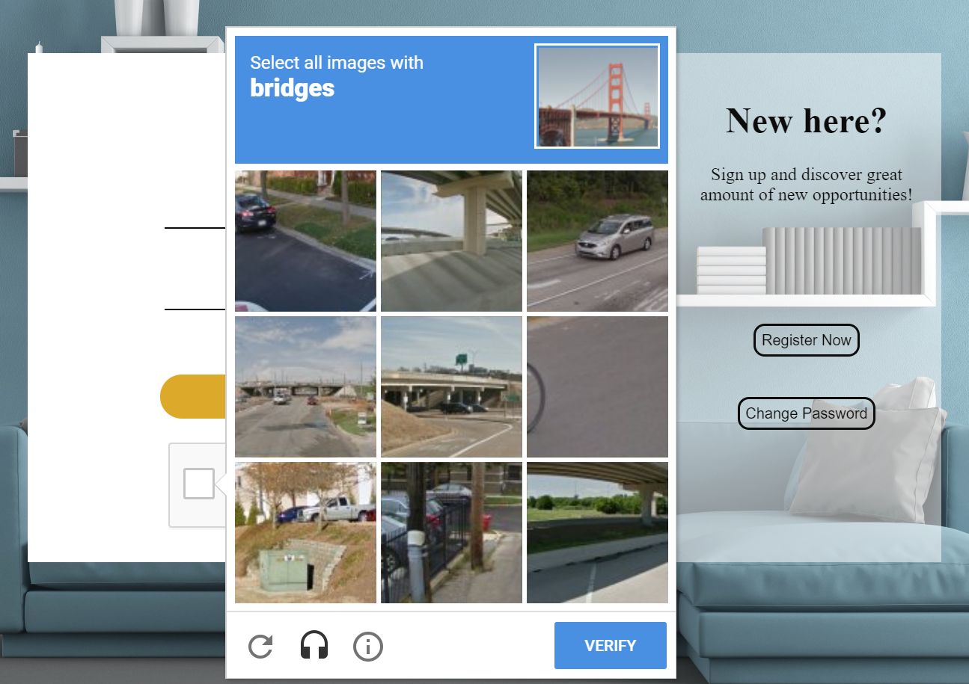

Slide 7
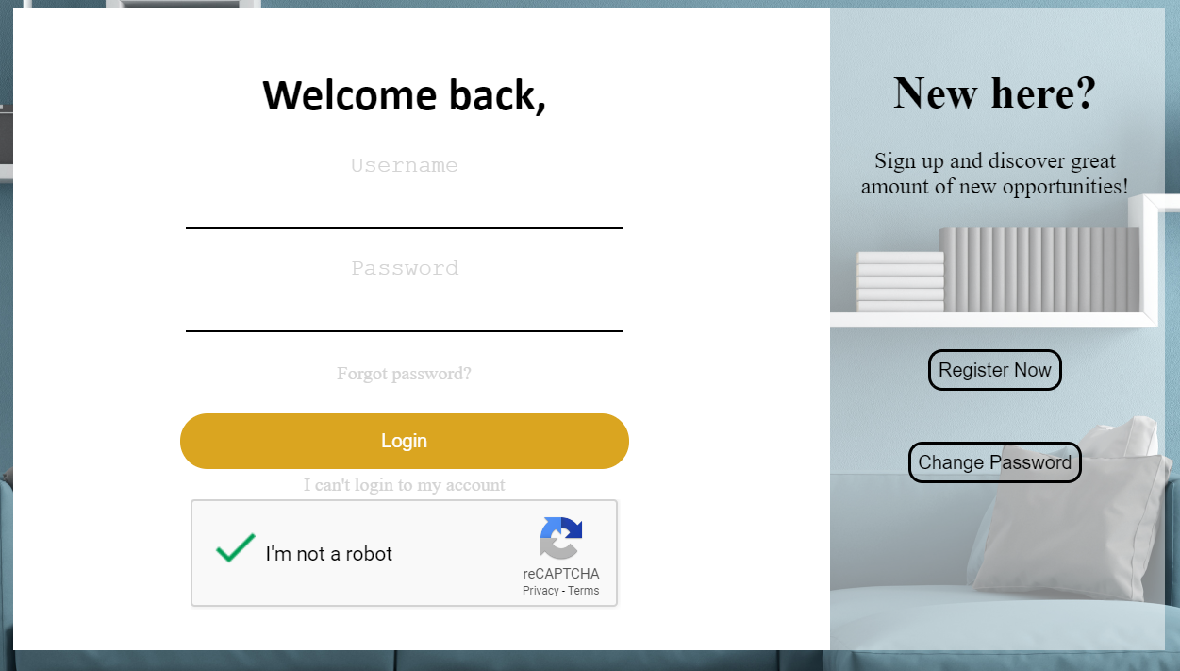

Slide 8



Login Process
Create a session (encrypted) for user
Redirect user to Home Page
Retrieve Hashed Password
Hash and Salt Password
Verify Password
‘Login’
Validation
Invalid Password
3 attempts used
Validation Failed
Re-captcha Failed
Invalid Username
Email sent through SMTP port 587 (SSL-Encrypted)
Provides Confidentiality through TLS
Email Server

Slide 9
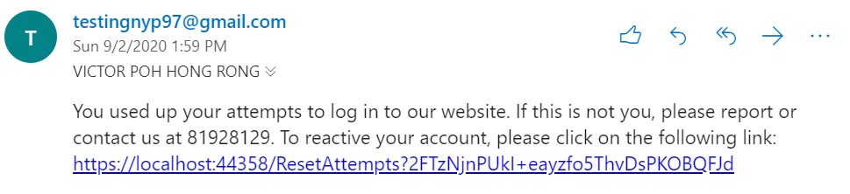

‘FailedLogins’ Table

Slide 10
User Account Policy
Name must be between 4 and 16 characters (inclusive)
Name cannot contain any special character (e.g. *<>!=_)
^([_A-z0-9]){4,16}$
Password MUST BE between 7 and 20 characters (inclusive)
Password must contain at least one number, one lowercase and one uppercase letter, and one special character
Password must be changed every 30 days
Password can only be changed every 3 days
^(?=[a-zA-Z0-9!@#$%^&*()+_{};:'<>,./?-]{7,20}$)(?=.*?[a-z])(?=.*?[0-9])(?=.*?[!@#$%^&*()+_{};:'<>,./?-]).*
Email must be valid (\w @ [numbers/letters] . [numbers/letters] . …)
^\w+@[a-zA-Z0-9_]+?(\.[a-zA-Z]{2,20}){1,10}$

Slide 11
Forgot Password Process
Send Email
containing new password
Send Email
containing new password
‘Forgot Password’
Validation
Email Server
Email sent through SMTP port 587 (SSL-Encrypted)
Provides Confidentiality through TLS
Update new password for user
Validation Failed
Username doesn’t exist
Function used recently (3< days)

Slide 12
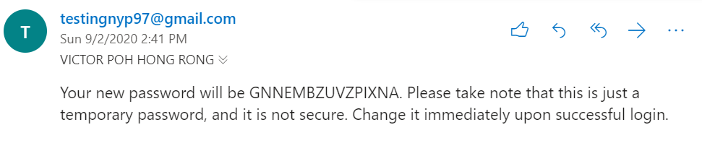

Slide 13
Change Password Process
Retrieve Hashed Password
Hash and Salt old Password
Verify Password
‘Change Password’
Validation
Invalid Password
Update new password for user
Validation Failed
Invalid Username
Old Password == New Password

Slide 14
Help Pages for Users
User Guide Page
Password Policy
Secure Account
Pre-order Food
Pre-ordering food (buyer version)
Pre-ordering food (seller version)

Slide 15
POFLocation
What is it?
Here, users can view all the stalls registered with our website
Location (Where the stall is located at, e.g. Nanyang Polytechnic)
Stall (Name of the stall)
Located exactly at (e.g. Level 1, #01-25)
Open (user can order food from the stall)
Close (user can only view the menu inside the stall, but cannot order)
How to use?
“Select Location” Bar for user to search for the location they are interested in (i.e. Location near where they are currently/near their house)
Click on the stall name to enter the stall and view the menu inside

Slide 16
POFStall
What is it?
Here, users can view the menu in the stall and decide what to order
Price
Comments (Optional description of the food, e.g. vegetarian, contains seafood)
Review (Average review given to the food by all users who ordered it)
How to use?
Click on the food name or the ‘Order’ icon on the right to view detailed information of the food before the final step of placing an order

Slide 17
POFOrder
What is it?
Here, users can see the forum of review comments given by users who had pre-ordered the food
Pax (How many of the food the user is ordering)
Collection Time (Estimated time the user will arrive at the stall for food collection) (based on the concept of queue)
How to use?
Click on the ‘Confirm Order’ button to place order on the food (proceed to demo first)
Demo
Demo with POFCustomerRequests

Slide 18

Concept of Queue
Each person estimated 2 minutes

Slide 19
POFRequestsCategory
What is it?
Here, stall owners can view their stall and each stall’s incoming request
How to use?
Click on the stall name to view incoming requests

Slide 20
POFCustomerRequests
What is it?
Here, stall owners can view incoming requests
Realtime SqlDependency between web server and database
Realtime SignalR between web server and client to send incoming requests
How to use?
Click on ‘Confirm purchase’ to view detailed information of each incoming request when the buyer has arrived

Slide 21


Ordering Process
Validation
SignalR
Send incoming request to seller(stall owner)
Buyer places order
Validation failed
Insert new order record
SqlDependency
Update web server that DB change was made

Slide 22
POFConfirmOrder
How to use?
Click on the ‘Return’ button to return to POFLocation
Click on the ‘Order Slip’ button to view order slip (used for collection of food)
POFReceipt
What is it?
Prove that order was made by the user (authenticity) to collect the food from the stall owner

Slide 23
POFWaiting
What is it?
For users to track their orders and view their order slip
How to use?
Click on the food name to view the order slip
Click on the ‘Report’ icon on the right to report the stall owner if order request is delayed too long / the stall is fake
POFReceipt
What is it?
Prove that order was made by the user (authenticity) to collect the food from the stall owner

Slide 24
POFRequests
What is it?
For seller to track detailed order details from each different buyer and to confirm purchase
How to use?
Search function to search for buyer’s name for convenience purpose
Click on the ‘tick’ icon to confirm purchase
Click on the ‘warning’ icon to report buyer (e.g. if buyer didn’t turn up)

Slide 25

Confirm Purchase Process
Server
Seller clicks on ‘tick’ icon
Unlock review form
Update database record

Slide 26
POFReviews
What is it?
For buyer to give review to the food that they had ordered and received
How to use?
Click on the food name or the icon on the right to obtain the review document

Slide 27
POFCompleteReview
What is it?
For buyer to give review to the food that they had ordered and received
Review (0-10)
Write a comment (optional comment for the food that will be posted on the forum)
How to use?
Click on the ‘tick’ button to submit the review document

Slide 28
POFSell
What is it?
For sellers to sell their food / update their food details
Location (Where the stall is located at, e.g. Nanyang Polytechnic)
Stall (Name of the stall)
Located exactly at (e.g. Level 1, #01-25)
Image (an image for the buyer to preview the food)
Food (the actual name of the food)
Price
Comments (Optional description of the food, e.g. vegetarian, contains seafood)
How to use?
Click on the ‘Complete’ button to sell the food / update the food details

Slide 29

Selling Process
Update record
Redirect seller to ‘display successful message’ page
Validation
isEdit?
Yes
Insert record
No
Seller clicks on ‘complete’ button
Yes
Redirect seller to ‘display successful message’ page
Stall Exists?
Validation failed
No
Redirect seller to POFManage

Slide 30
POFManage
What is it?
For sellers to manage their stall(s)
Location (Where the stall is located at, e.g. Nanyang Polytechnic)
Stall (Name of the stall)
Located exactly at (e.g. Level 1, #01-25)
Working Days (When will the stall be operating?)
Opens & Closes (How long will the stall be operating?)
How to use?
Click on the ‘Update’ button to sell the food / update the food details

Slide 31
POFHistory
What is it?
For buyers to track their order history
POFSellHistory
What is it?
For sellers to track their sold history

Slide 32
POFUserGuide
What is it?
A guide to use pre-ordering function for buyers
POFSellerGuide
What is it?
A guide to use pre-ordering function for sellers

Slide 33
AdminLogin
What is it?
For admin to login
Account name and password is given by us
MAC address is pre-set to allow only specific computer to gain access

Slide 34
Admin Login Process
Create a session (encrypted) for user
Redirect user to Admin Home Page
Retrieve Hashed Password
Hash and Salt Password
Verify Password
‘Login’
Validation
Invalid MAC
Invalid Password
3 attempts used
Validation Failed
Re-captcha Failed
Invalid Username
Email sent through SMTP port 587 (SSL-Encrypted)
Provides Confidentiality through TLS
Email Server
Disable Account

Slide 35
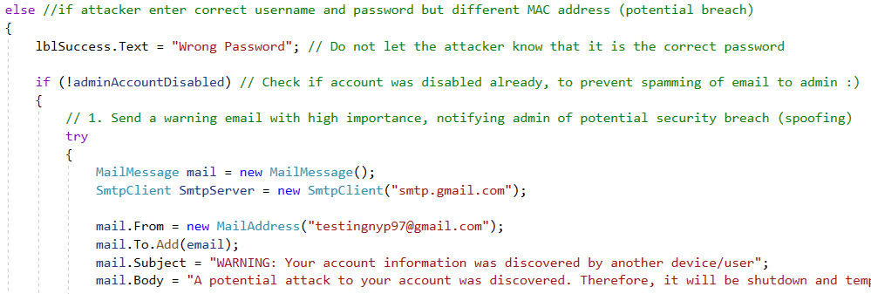
‘Admin’ Table

Slide 36
AdminHome
What is it?
For admin to view registered users and remove them as necessary

Slide 37
LogsSR
What is it?
For admin to view the web application’s log
Real-time SignalR-supported
Date of Event (When did the event occur)
Level
INFO: Normal Application Events
WARN: Potential Attacks / Threats
ERROR: Application Errors
FATAL: Threat / Attack that exploited our Application’s Vulnerabilities
Logger (On which page did the event occurred on)
Message (The actual message for the event)

Slide 38
StaticLog
What is it?
For admin to view the web application’s log
Same as LogsSR, except that it is not real-time, but
Provides search functionality based on ‘Level’, Event date time, and/or ‘Message’
Date of Event (When did the event occur)
Level
INFO: Normal Application Events
WARN: Potential Attacks / Threats
ERROR: Application Errors
FATAL: Threat / Attack that exploited our Application’s Vulnerabilities
Logger (On which page did the event occurred on)
Message (The actual message for the event)

Slide 39
IPAddressInformation
What is it?
For admin to view IP Address information of attackers
Important information include
City
Postal Code
Country
Coordinates (Geolocation)
Time
Provider

Slide 40
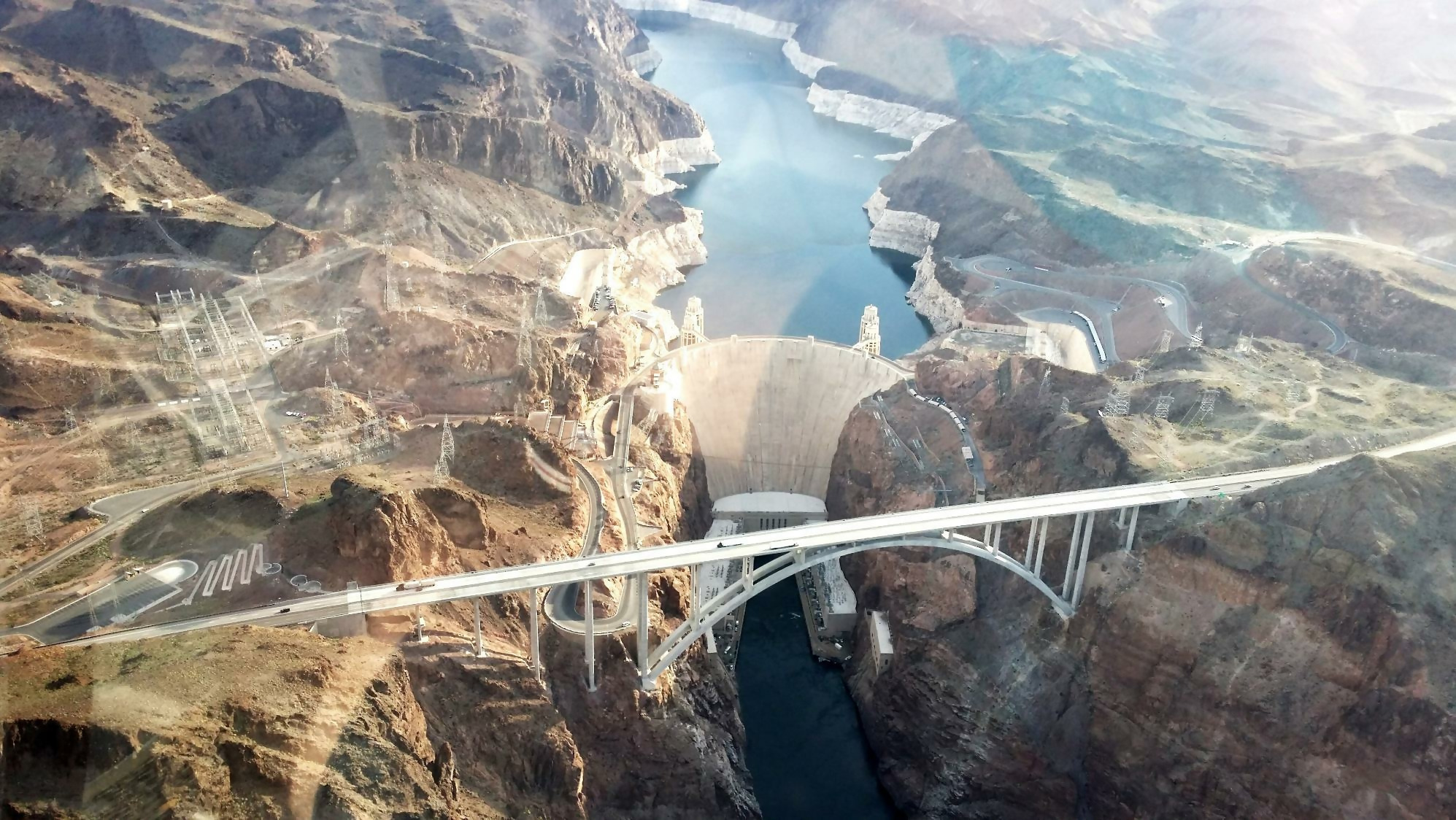
Thank You

